Slide 1

CineMood AI: Where AI meets Emotion
Meet our Dedicated Team Members
Subrat Mishra
Nandini Yeddula
Nandan S R
Ragavendra S
Aditya G Hiremath
P Arjun

Slide 2
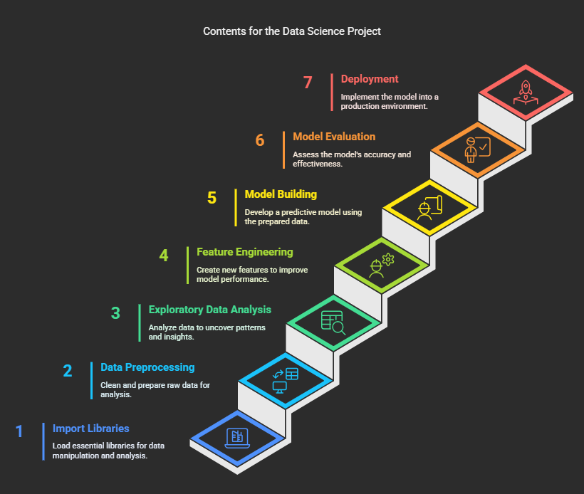
CONTENTS
Project Description
Import Libraries
Data Preprocessing
Exploratory Data Analysis
Feature Engineering
Model Building
Model Evaluation
Deployment

Slide 3
PROJECT DESCRIPTION Utilizing machine learning to predict IMBD sentiment analysis
CineMood
AI is a cutting-edge, AI-powered web application designed to intelligently interpret and classify user-generated movie reviews. Leveraging advanced Natural Language Processing (NLP) techniques and deep learning models, the system identifies sentiment ranging from strongly negative to extremely positive, enabling a deeper understanding of audience emotions.
Built with Streamlit for a seamless UI and TensorFlow/Keras for backend intelligence, the platform provides real-time predictions along with an interactive confidence meter, animated visuals, and a user-centric design to maximize engagement.
🧠 Core Objective
To develop an intelligent system that can automatically assess movie reviews and provide instant sentiment classification.
To enhance user interaction with a visually appealing, dynamic interface.
To combine NLP + Deep Learning for accurate and scalable text sentiment interpretation.

Slide 4
Loading And Exploring The Dataset
The dataset was extracted using the IMDB API, containing real user-submitted movie reviews.
Each review is paired with a corresponding sentiment label:
1 → Positive Review
0 → Negative Review
The dataset reflects genuine audience opinions, ensuring real-world relevance.
Performed initial data validation:
Checked for missing values

Slide 5
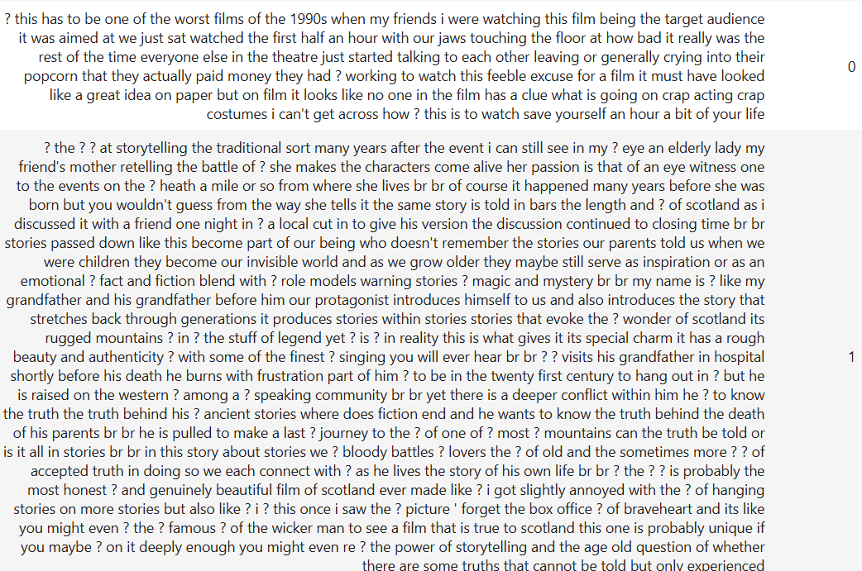
A Sample from Dataset

Slide 6
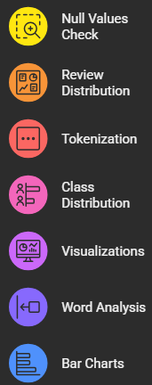
Exploratory Data Analysis
Checking for null values and missing data.
Distribution of Positive Reviews vs. Negative Reviews .
Tokenizing news articles and visualizing the most frequent terms.
Checked class distribution in the dataset (Positive Reviews vs. Negative Reviews ).
Created visualizations using Seaborn and Matplotlib.
Analyzed the number of words in titles and articles.
Created bar charts for Reviews .

Slide 7
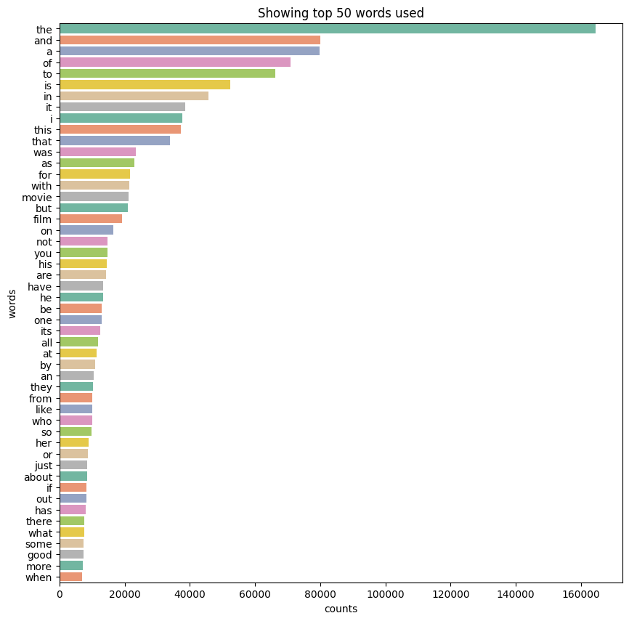
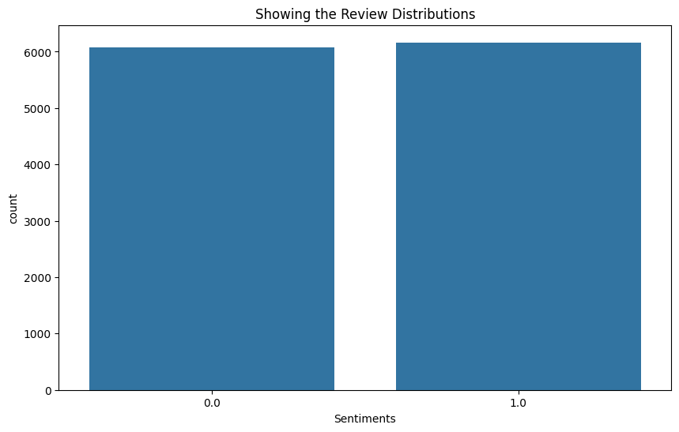
Data Visualization

Slide 8
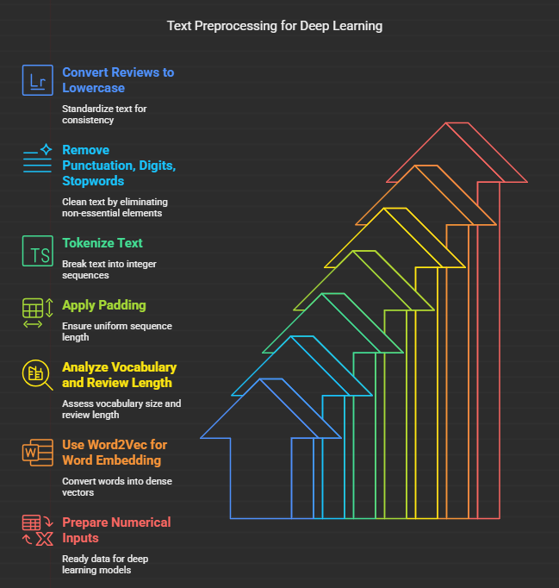
FEATURE ENGINEERING
Converted all reviews to lowercase for consistency.
Removed punctuation, digits, and stopwords to clean the text.
Tokenized the cleaned text into sequences of integers.
Applied padding to ensure uniform sequence length (837 words).
Analyzed vocabulary size and maximum review length.
Used Word Embedding (Word2Vec) to convert words into dense vectors.
Embedding dimension set to 10 for compact word representation.
Prepared numerical inputs ready for deep learning models.

Slide 9
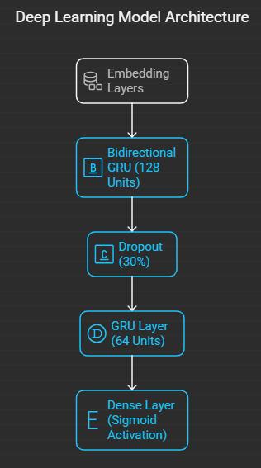
MODEL BUILDING
Deep Learning Model:
Embedding Layers: Transform word indices into dense 300-dimensional vectors, capturing semantic meaning.
Bidirectional GRU(128 Units): Processes sequences in both forward and backward directions to capture contextual information from both past and future words.
Dropout (30%): Prevents overfitting by randomly dropping units during training.
GRU Layer (64 Units): Further learns temporal dependencies in the text
Dense Layer (Sigmoid Activation): Outputs a probability score for binary classification (positive or negative sentiment).

Slide 10
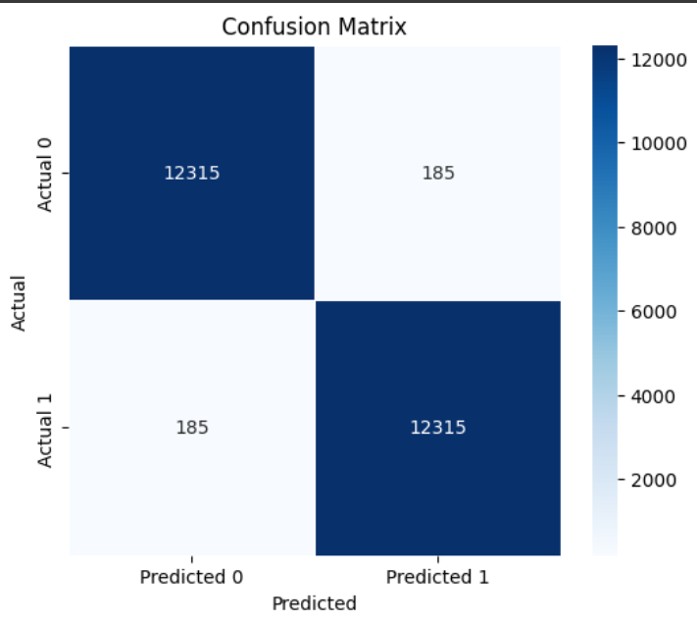
Confusion Matrix
1. Overall Accuracy
Out of 25,000 prediction 24,630 are correct. This gives an accuracy of 98.52% indicating excellent performance.
2. Balanced Performance
-> True Negatives (TN): 12,315 → Model correctly predicted class 0.
-> True Positives(TP): 12,315 → Model correctly predicted class 1.
-> False Positives (FP): 185 → Model predicted 1 when the actual label was 0.
-> False Negatives (FN): 185 → Model predicted 0 when the actual label was 1.

Slide 11
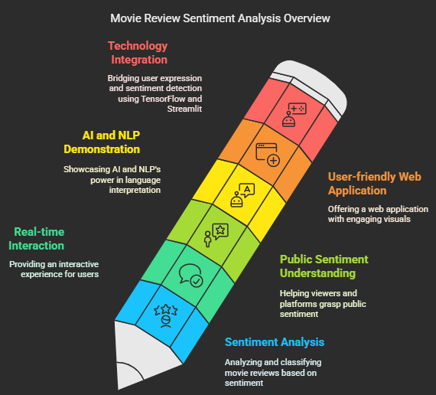
PURPOSE OF THE PROJECT
To build an intelligent system that automatically analyzes and classifies movie reviews based on sentiment.
To offer a real-time, interactive experience for users submitting their opinions on movies.
To help viewers and platforms understand public sentiment towards movies using deep learning techniques.
To demonstrate the power of AI and NLP in interpreting human language with high accuracy.
To provide a user-friendly web application with engaging visuals and interactive feedback.
To bridge the gap between user expression and automated sentiment detection using TensorFlow and Streamlit.

Slide 12

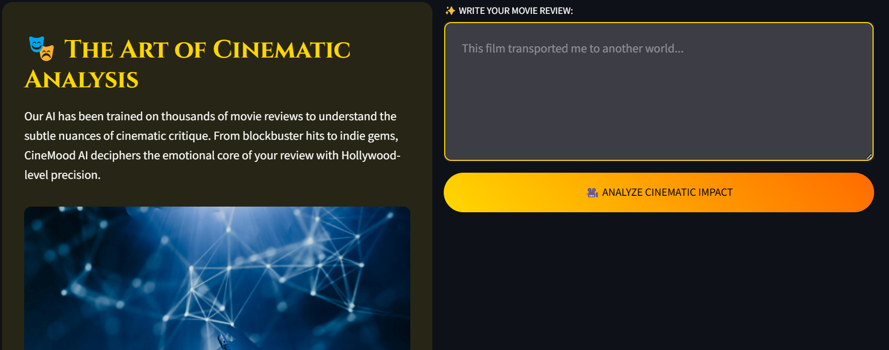
MODEL DEPLOYMENT
Click Here to explore CineMod AI

Slide 13
THANK YOU

